Slide 1
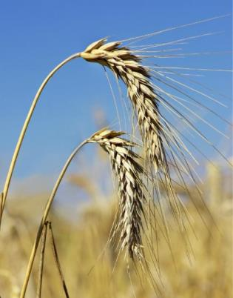
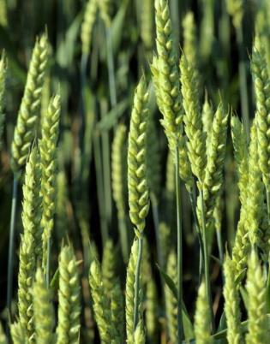
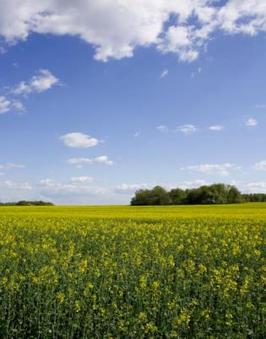
Hydro-Meteorological data
Australian Bureau of Meteorology

Slide 2
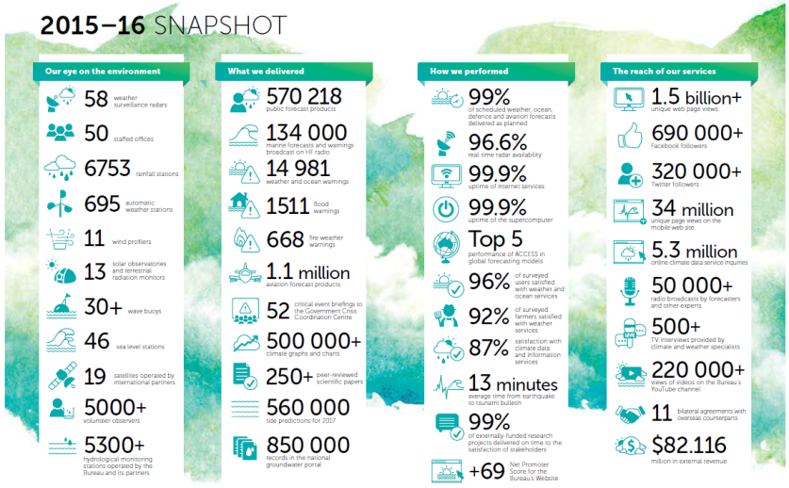
Notes:
The Bureau of Meteorology is Australia's national weather, climate and water agency. Its expertise and services assist Australians in dealing with the harsh realities of their natural environment, including drought, floods, fires, storms, tsunami and tropical cyclones.
Through regular monitoring, forecasts, warnings and advice spanning the Australian region and Antarctic territory, the Bureau provides one of the most fundamental and widely used services of government.
The Bureau of Meteorology operates under the authority of the Meteorology Act 1955 and the Water Act 2007.
National flood warning was a Bureau function prior to the Water Act and was strengthened though the Water Act.
In 2008 and following the millennium drought, the Australian Government announced an investment programme to secure long-term water supply for all Australians. This included funding the Bureau for 10 years to deliver the Improving Water Information Programme, in conjunction with key water industry stakeholders.
Prior to this programme, water organisations within Australia were unable to interoperably share water data within the nation.
The Water Act has been a key enabler in Australia's ability to understand the status of water across the land scape, the Act makes the sharing of water data with in Australia a legal obligation.
The Bureau has 1800 staff, as well as 260 paid cooperative observers and over 5000 volunteer observers.
The Bureau's web site is the most popular Australian Government website with over 1.5 billion unique page views and 34 million unique mobile web site views.
We have just released a user location focused mobile app the provides situation awareness and forecast information.

Slide 3
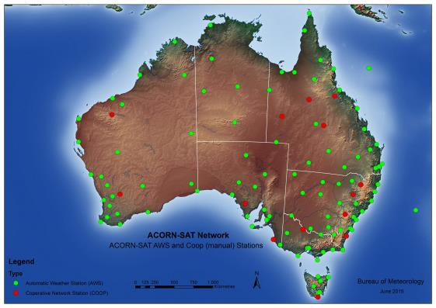
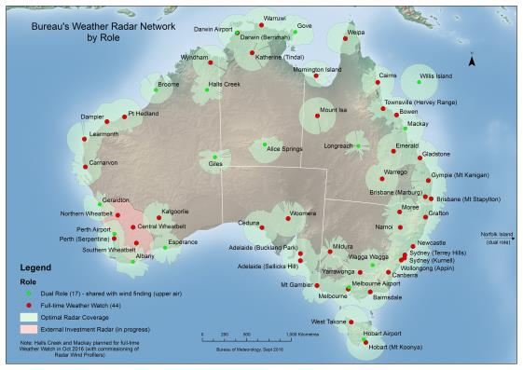
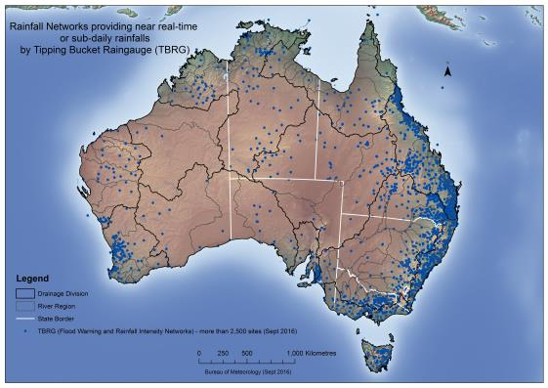
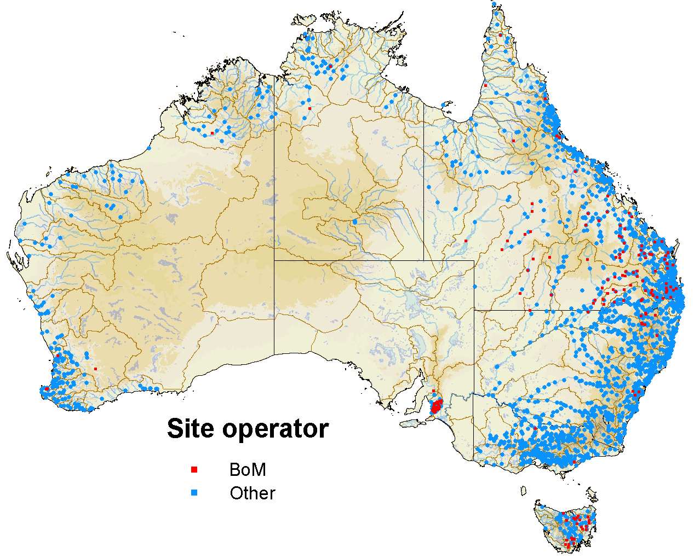
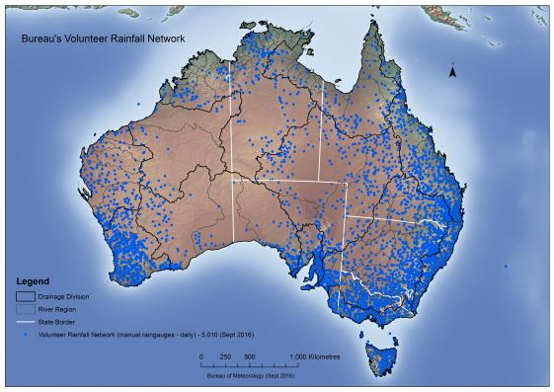
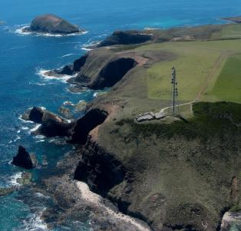
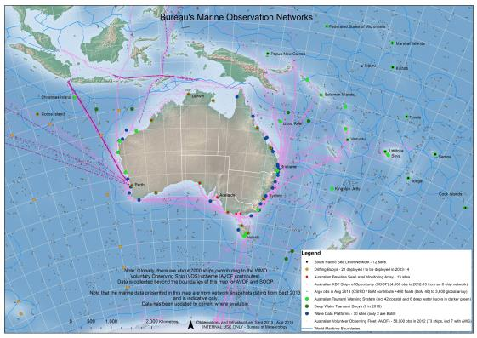
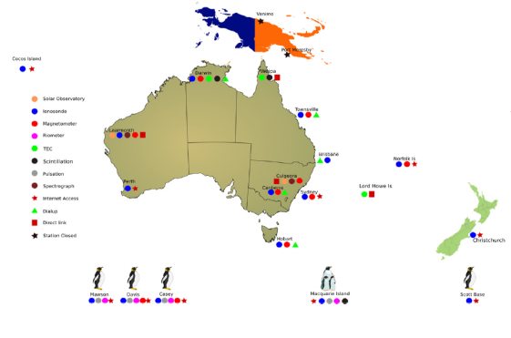
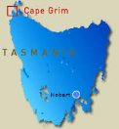
Observation network
Automatic weather stations
Radar
Automated rain gauge
Flood warning
Volunteer rainfall
Base line air quality
ACORN SAT
Marine
Space weather
Notes:
Automatic weather stations
We operate 695 automatic weather stations monitoring a broad range of meteorological parameters from rainfall to solar radiation
Radar
Our weather Watch radars are and effective observational tools for the detection of rain.
Bureau forecasters can interpret the patterns and intensity of the radar images to provide warnings of major weather events such as severe thunderstorms, tropical cyclones and areas of heavy rainfall.
We operate 41 dedicated weather watch radars along with 17 radars with combined weather watch and wind finding capabilities.
Automated rain gauge
We operate a tipping bucket rain gauge network for weather forecasting, flood warning and rainfall intensity purposes – The network has more than 2500 telemetered sites.
Flood monitoring
Our flood warning network involves close to 7000 rain and river sites.
The majority of the flood warning rainfall sites are owned and operated by the Bureau however the majority of river level stations are owned by other agencies, predominantly the states and territory governments.
Volunteer rainfall
Our volunteer rainfall network has over 5000 manually observed rain gauges. Our volunteer observers include farmers, local government employees and interested members of the public.
The network provides for national coverage of daily rainfall observations, this data is used in climate analysis and reporting as well as extreme event impact assessment.
Our volunteer source records undergo extensive quality assurance validation processes to ensure their accuracy and to minimise errors associated with manual recording methods.
Base line air quality
The Bureau operates the Cape Grim Baseline Air Pollution Station, the station was established in 1976 to monitor and study global atmospheric composition.
It measures:
greenhouse gases such as carbon dioxide, methane and nitrous oxide.
stratospheric ozone depleting chemicals, such as chlorofluorocarbons (CFCs)
the station also monitors the full suite of meteorological parameters
ACORN –SAT
Within our observation network we have identified 112 stations with long term high quality surface air temperature records to form the Australian Climate Observations Reference Network for Surface Air Temperature.
The ACORN-SAT dataset has been established to monitor climate variability and change in Australia.
Marine
The marine observing network monitors sea level around Australia and performs Tsunami warning across the region using:
Drifting buoys
Tsunami buoys
Argo floats
Wave buoys
Space Weather
The Bureau operates 2 solar observatories and 14 field observation stations to monitor space weather.
Space weather refers to changes in the space environment, particularly the region between the Earth and Sun. A continuous flow of charged particles from the sun or "solar wind" streams past the Earth. Variations in the solar wind such as those caused by solar flares, can cause changes in the Earth's magnetic field.
Solar flares can:
Cause unexpected electric currents in long conductors like power lines and pipe lines.
Disrupt radio communications in the Poles for days to weeks at a time, causing aircraft flying over the Poles to have limited radio contact resulting in alternate flight paths being used.
Decrease the precision the Global Positioning Systems network used for navigation in ships, aircraft, and vehicles.

Slide 4
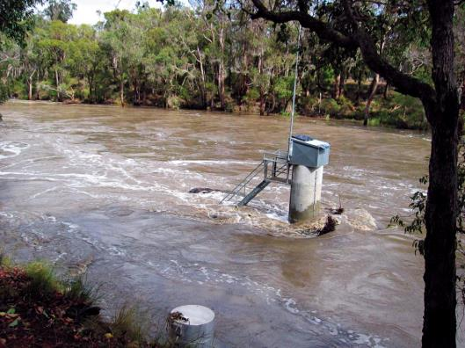
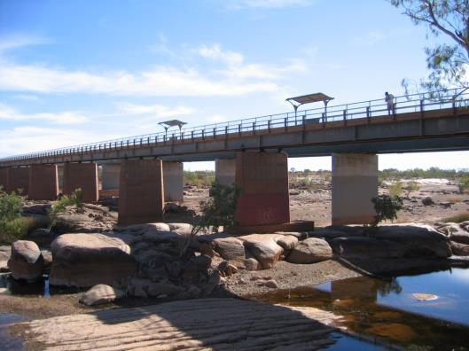
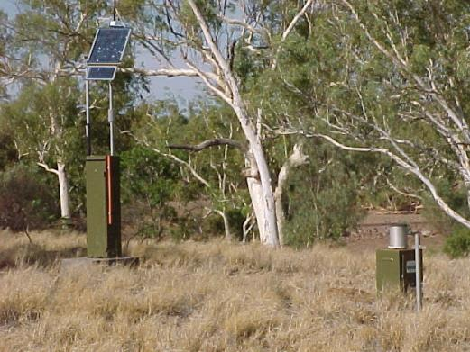
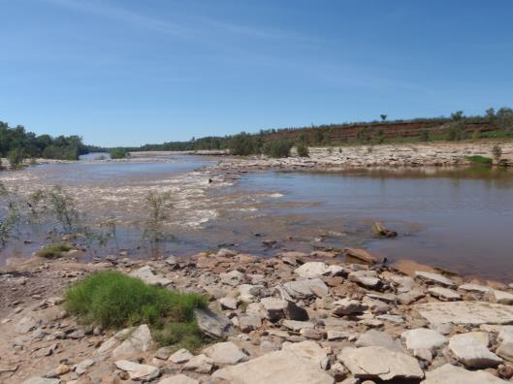
State hydrometric networks
Western Australia
Department of Water
2500 Bores
300 Gauging Stations
190 Rainfall and climate
900 Surface water quality
Notes:
Western Australia – Department of Water
The department is one over 230 Water Act data providers to the Bureau. The Department provides flood warning data and water resource data.
Ground water aquifers are an important part of the States water supply system.
The Department data sharing is two speed – high response for flood warning and a more complete water resource assessment feed that includes metadata such as ratings.
DOW owned network that is part of a current monitoring program
Bores ~ 2500
Gauging Stations ~ 300
Rainfall and climate ~ 190
Water quality (surface water) ~ 900
99% of the Departments gauging stations and rainfall sites send data via IP telemetry using a mix of technologies including land lines, mobile and satellite communications.
Of the 2500 bores operated by the Department, most are observed manually with approximately 500 bores being equipped with data logging equipment, there is no telemetry on the ground water network.
The department manages 34,000 years of continuous observations timeseries data within their Hydstra system.
The Department receives approximately 5000 water quality samples per month and manages over 15 million sample of ground water observations through their 'WINs – Water Information system', the department is currently migrating all data into a commercial system.

Slide 5
Processes
Observations
Data systems
Modelling
Products
RTDB
MARS
ADAM
AWRIS
- Public forecasts
- Aviation
- WMO message publication
- Flood warnings
- Water in Australia
- Regional water information
- 7-day Streamflow
- Seasonal Streamflow
Surface
Land & Ship
Upper air
Ocean
Satellite
Rivers
Water Storage
Ground water
Access
Global
Regional
City
Tropical
FEWS
AWRA
Seasonal stream flow
ASOS
CMSS
Notes:
Processes are substantially more complicated than this high level view diagram.
Largely the process is one of adding value to the observations made by the Bureau and partner agencies by curating the data in data systems, using modelling to develop forecasts and explore scenarios and produce products that inform safety, security and economic decisions by governments, industry and the community.
Flood operations
The flood systems process around 310,000 river height and flow observations/day and 160,000 rainfall observations day.
The system processes around 345,000 derived 15 minute observations per day.
AWRIS
In excess of 12000 data files received per day. Our Wiski data system is a proprietary component of the AWIRS system contains in excess of 18 billion observations and derived values.
The system contains data from over 22 000 monitoring locations covering Water Quality, Ground water, Rivers , storages and meteorological parameters.
Modelling
The "Australian Community Climate and Earth-System Simulator" our ACCESS model – Runs on the BoM supercomputer.
AWRA Landscape, Ground water – runs on the national computer infrastructure, a research supercomputer.
Flood warning modelling on the FEWS system runs on our mid-range, virtualised infrastructure.
Seasonal stream flow and seven day forecasts also run on the mid-range infrastructure.
Central message switch
The CMSS is highly available message switching software that moves data between processes for modelling, forecasting , product generation and delivery. It also delivers data to external consumers.
CMSS moves 165Gb of Himawari H8 data per day and 135 Gb of ACCESS model data produced by the Australis SC per day.
CMSS receives on average 4 million messages per day and sends on average 23 million messages per day.

Slide 6
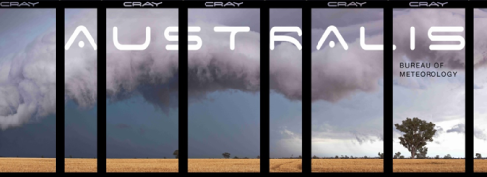
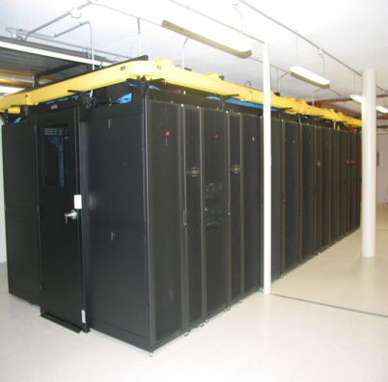
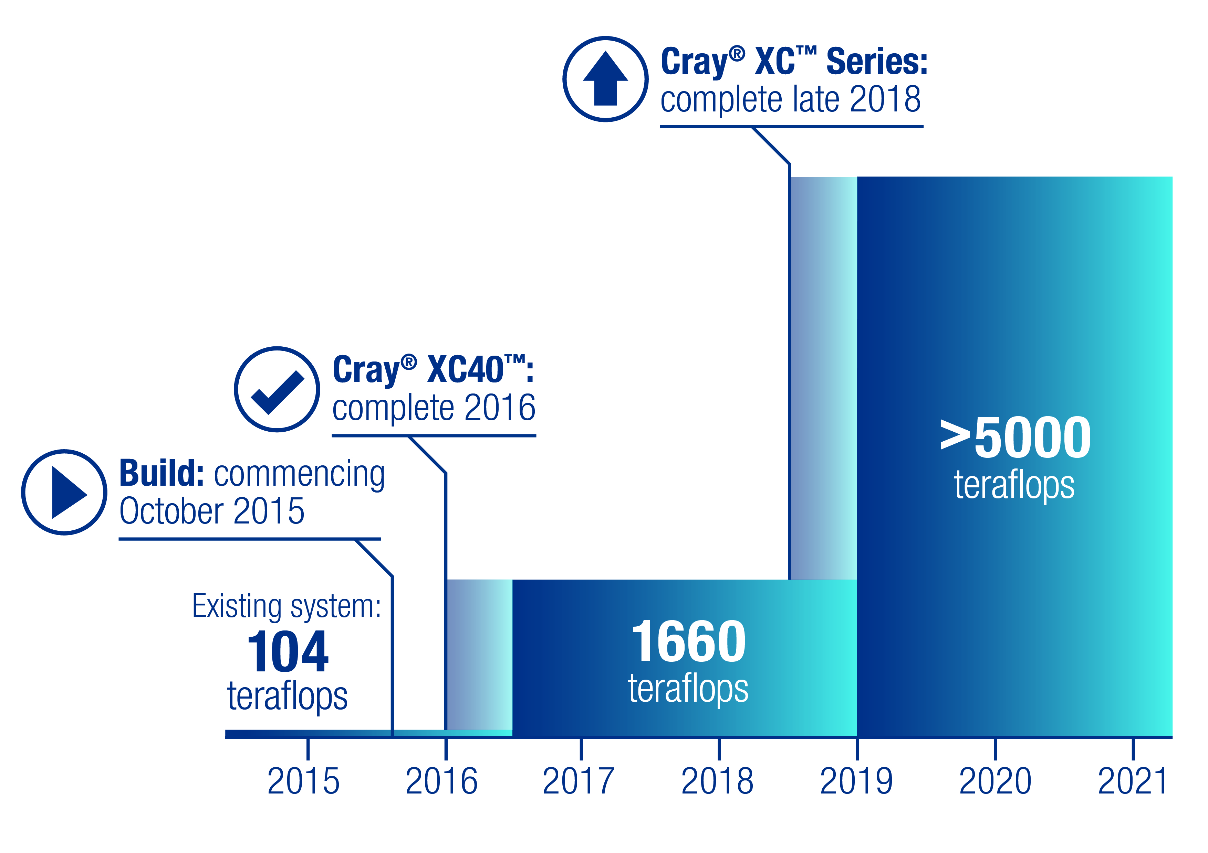
Infrastructure
Supercomputer
commissioned in June 2016
National computing infrastructure
Mid range infrastructure
Business continuity planning
Research
1220 teraflops
Notes:
The new supercomputer was commissioned in June 2016.
Forecasts will be more accurate, by increasing forecasts and warnings from the current 4 km grid resolution for cities four times a day to a 1.5 km grid resolution for cities up to 24 times a day in 2020,
Forecasts will be more certain—by using ensemble forecasts to quantify the probability of forecasts.
Forecasts will be more responsive—the Bureau will have capacity to run cycles more often and to provide on-demand forecasts in response to severe weather events and to cover multiple events concurrently.
NCI
Is a National Computing Infrastructure is a shared supercomputer that is used by a number of government and research institutions.
Midrange infrastructure
We are increasing the use of commercial cloud and content delivery capabilities. This is Australian government policy inline with the policy goal of:
The Australian Government will reduce the cost of government ICT by eliminating duplication and fragmentation and will lead by example in using cloud services to reduce costs, lift productivity and develop better services
Business continuity planning
To maximise the use of duplicated mid-range or load balanced / fail over cloud solutions, the applications must be designed to work in a high availability environment.

Slide 7
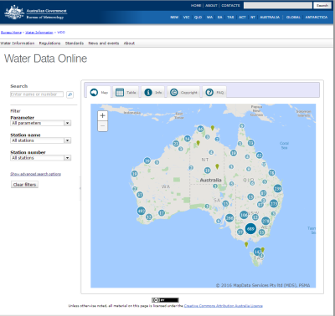
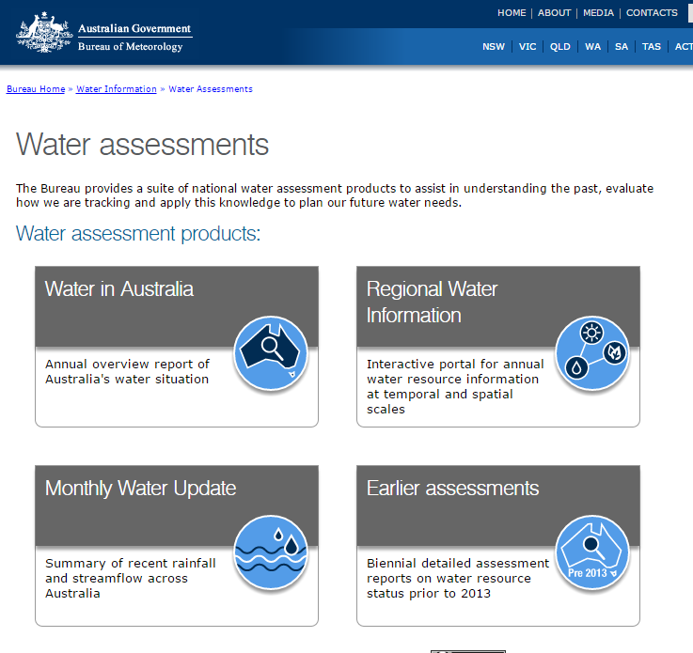
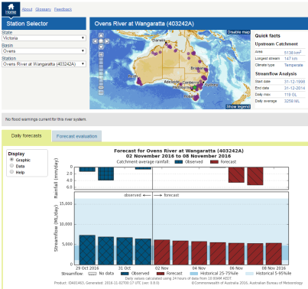
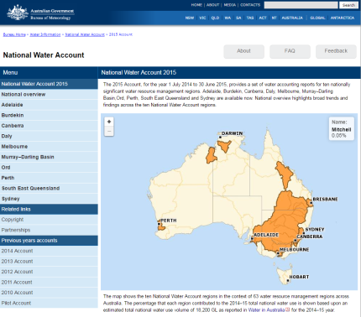
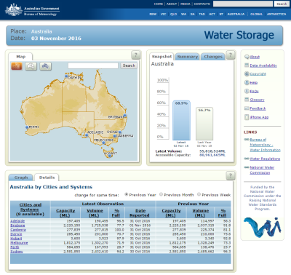
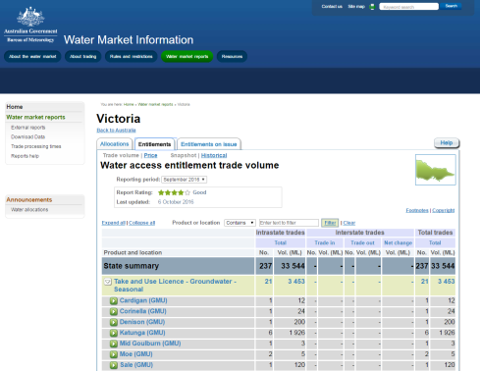
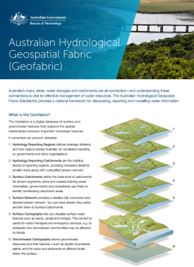
Water information products
Notes:
Water data online
This is Australia's first national hydrological data archive. National data is harmonised into a common structure and made freely available for public exploration and download, the archive is being updated with new and quality controlled observations continuously.
Water Assessments
A suite of national water assessment products to assist in understanding the past, evaluate how we are tracking and apply this knowledge to plan our future water needs.
Stream flow forecasts
The Bureau provides forecasts of how much water is likely to flow in a river, up to seven days ahead. The forecasts are available for more than a hundred sites around Australia. The forecasts are of value to water extractors, infrastructure operators, emergency services and recreation.
Season stream flow forecasts look forward for 3 months and provide water users and managers with a long term outlook for the decision making processes.
National water account
The National Water Account discloses information about water stores and flows, water rights and water use for key catchments and cities across Australia. It also reports on the volumes of water traded, extracted and managed for economic, social, cultural and environmental benefit.
Water storage
The Bureau of Meteorology's Water Storage website allows you to compare water storage levels and volumes for more than 300 publicly-owned lakes, reservoirs and weirs in different states and territories and to see how much water is available over the entire country.
Water market information
The Australian water market involves the trading of water entitlements and allocations within and between connected water resource systems for urban, rural and environmental uses.
Geo fabric
The Australian Hydrological Geospatial Fabric (Geofabric) is a specialised Geographic Information System (GIS). It registers the spatial relationships between important hydrological features such as rivers, water bodies, aquifers and monitoring points and enables us to see how water is stored, transported and used through the landscape.

Slide 8
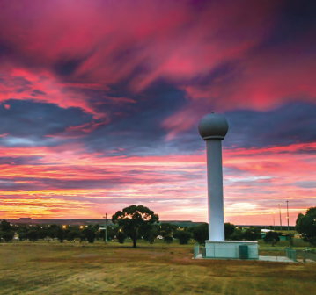
Thank you…
Paul Sheahan
+61 2 6232 3530
paul.sheahan@bom.gov.au

